Slide 1
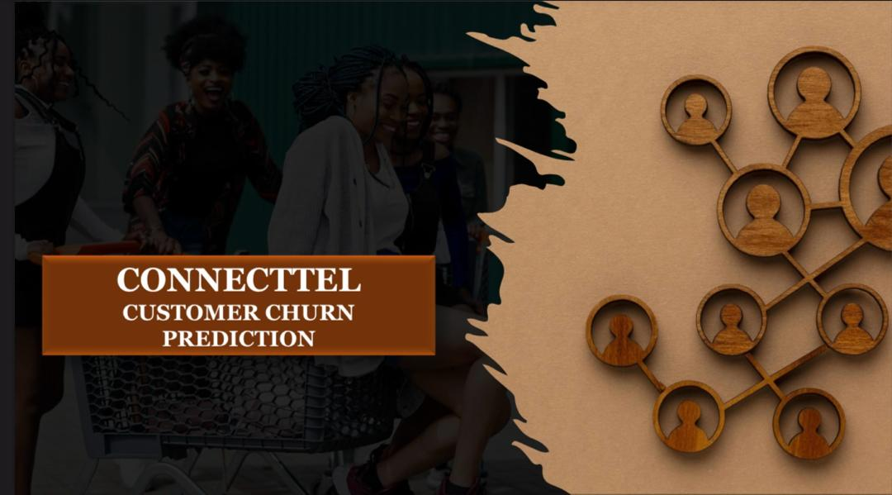

Project

Slide 2
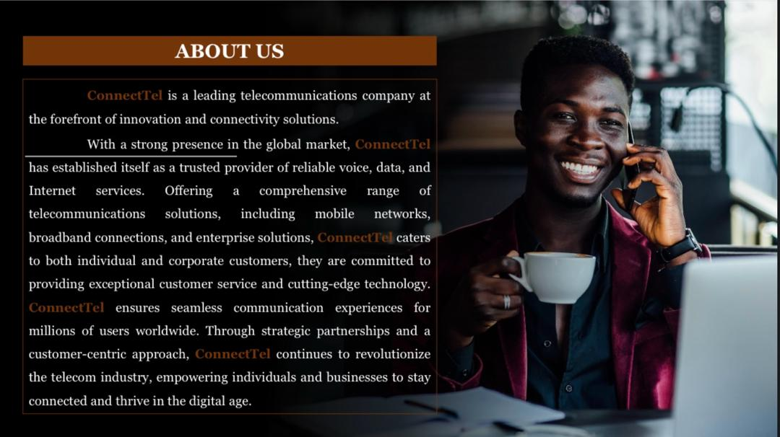
ABOUT US
ConnectTel is a leading telecommunication company known for its innovative connectivity solutions and global presence. It offers reliable voice, data, and Internet services to individual and corporate customers, including mobile networks, broadband connections, and enterprise solutions. With a commitment to exceptional customer service and cutting-edge technology, ConnectTel ensures seamless communication experiences for millions of users worldwide. Through strategic partnerships and a customer-centric approach, ConnectTel continues to revolutionize the telecom industry, enabling individuals and businesses to thrive in the digital age.

Slide 3
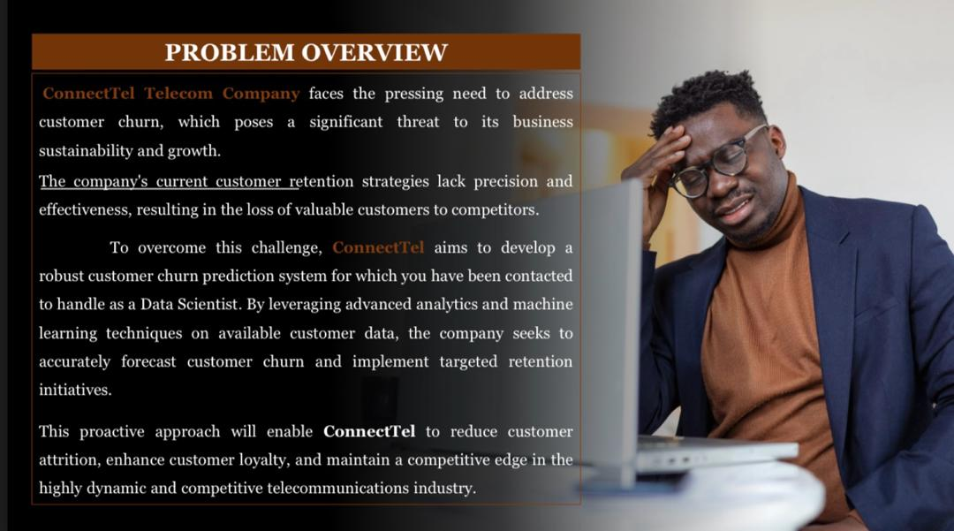
PROBLEM DEFINITION
ConnectTel Telecom Company faces a critical challenge with customer churn, posing a threat to its business sustainability and expansion prospects. Existing customer retention strategies lack precision and effectiveness, leading to the loss of valuable client to competitors. In response, ConnectTel has recognized the need to develop a robust customer churn prediction system.
Notes:
Problem Definition:
ConnectTel Telecom Company faces a critical challenge with customer churn, posing a threat to its business sustainability and expansion prospects. Existing customer retention strategies lack precision and effectiveness, leading to the loss of valuable clientele to competitors. In response, ConnectTel has recognized the need to develop a robust customer churn prediction system.
As a Data Scientist, my mandate involves leveraging advanced analytics and machine learning methodologies to comprehensively analyze existing customer data.
The objective is to accurately forecast customer churn and implement targeted retention initiatives.
Solution:
The proposed solution involves developing a sophisticated customer churn prediction system integrating advanced analytics and machine learning techniques. This system will analyze historical customer data to identify discernible patterns and precursory indicators of potential churn. Armed with these insights, ConnectTel can proactively implement measures to reduce customer attrition and enhance customer loyalty.
Benefits for ConnectTel:
Reduced Customer Attrition: Accurate identification of potential churners allows ConnectTel to preemptively intervene, thereby reducing attrition rates and safeguarding revenue streams.
Enhanced Customer Loyalty: Targeted retention initiatives informed by the churn prediction model demonstrate ConnectTel's commitment to customer satisfaction, fostering stronger customer bonds and heightened loyalty.
Competitive Edge: Customer retention is crucial for sustaining competitiveness in the telecommunications industry. By deploying a robust churn prediction system, ConnectTel can address customer churn effectively and deliver superior service offerings, thereby outmaneuvering competitors.
Cost Efficiency: Customer retention is a cost-effective alternative to acquiring new customers. By mitigating churn through tailored retention initiatives, ConnectTel can realize significant savings on marketing expenditures while maximizing customer lifetime value.
In summary, the development of a customer churn prediction system equips ConnectTel with the tools to mitigate churn risks, strengthen customer loyalty, and secure a lasting competitive advantage in the telecommunications landscape. This proactive approach safeguards revenue streams and positions the company for sustained growth and prosperity.

Slide 4
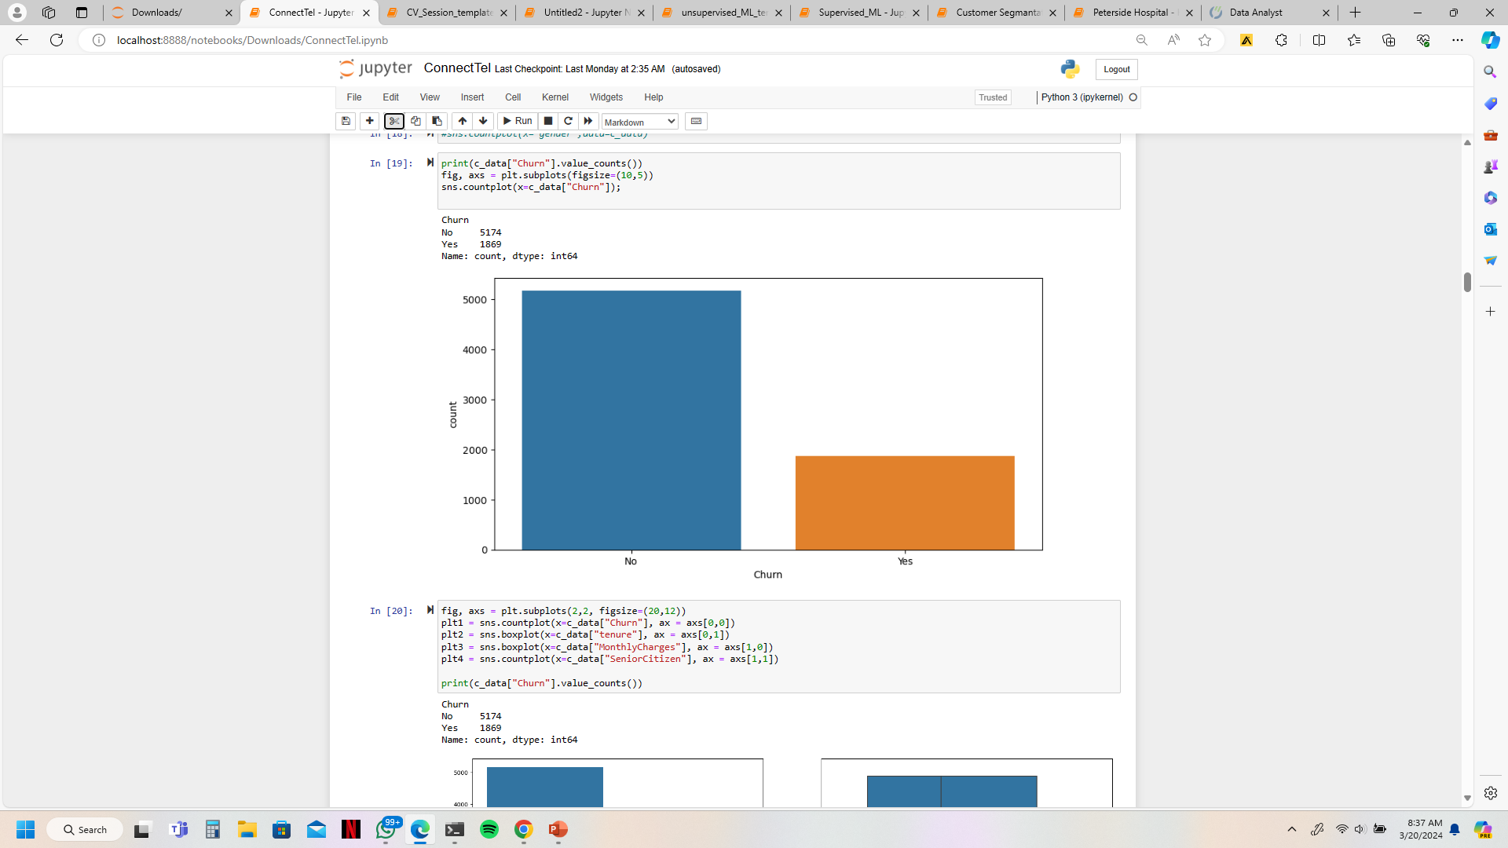

26.54%
73.46%

Slide 5

Advance Analytics
Existing Data
Machine Learning

Slide 6
Data Cleaning
Exploratory Data Analysis
Key Features
Visualization
Data Pre-processing
Feature Engineering
Encoding
Scaling
Machine Learning
Training and Testing of Models
Analyzing results of trained models and selecting the best model
Productionizing
Methodology

Slide 7
Project Workflow Overview
Importing Libraries
Importing Data
Data Dictionary
Data Copy
Data Cleaning
Checking for missing Data
Exploratory Data Analysis
Key Features
Visualization
Data Pre-processing
Feature Engineering
Encoding
Scaling
Machine Learning
Training and Testing of Data
Predictions with multiple Algorithm
Validating
Productionizing

Slide 8
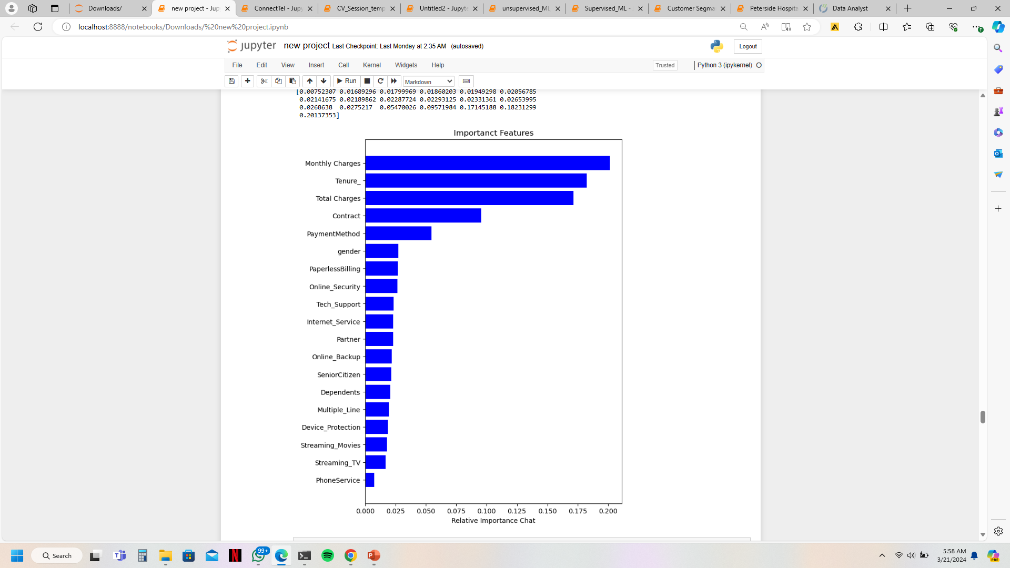
Importance by Columns
Notes:
Phone Service : 0.00760559
Streaming TV : 0.01778581
Streaming Movies : 0.01780945
Device Protection : 0.01919902
Internet Service : 0.01985875
Multiple Lines : 0.02045463
Dependents : 0.02154531
Online Backup : 0.02188052
Senior Citizen : 0.0234163
Partner : 0.02362029
Online Security : 0.02379187
Tech Support : 0.02514731
Paperless Billing : 0.02777884
Gender : 0.0293506
Contract : 0.09750222
Scaled Total Charges : 0.18639853
Scaled tenure : 0.20345316
Scaled Monthly Charges : 0.21340181

Slide 9
Observations
Min : 18.25
Max : 118.75
Min : 0
Max : 72

Slide 10
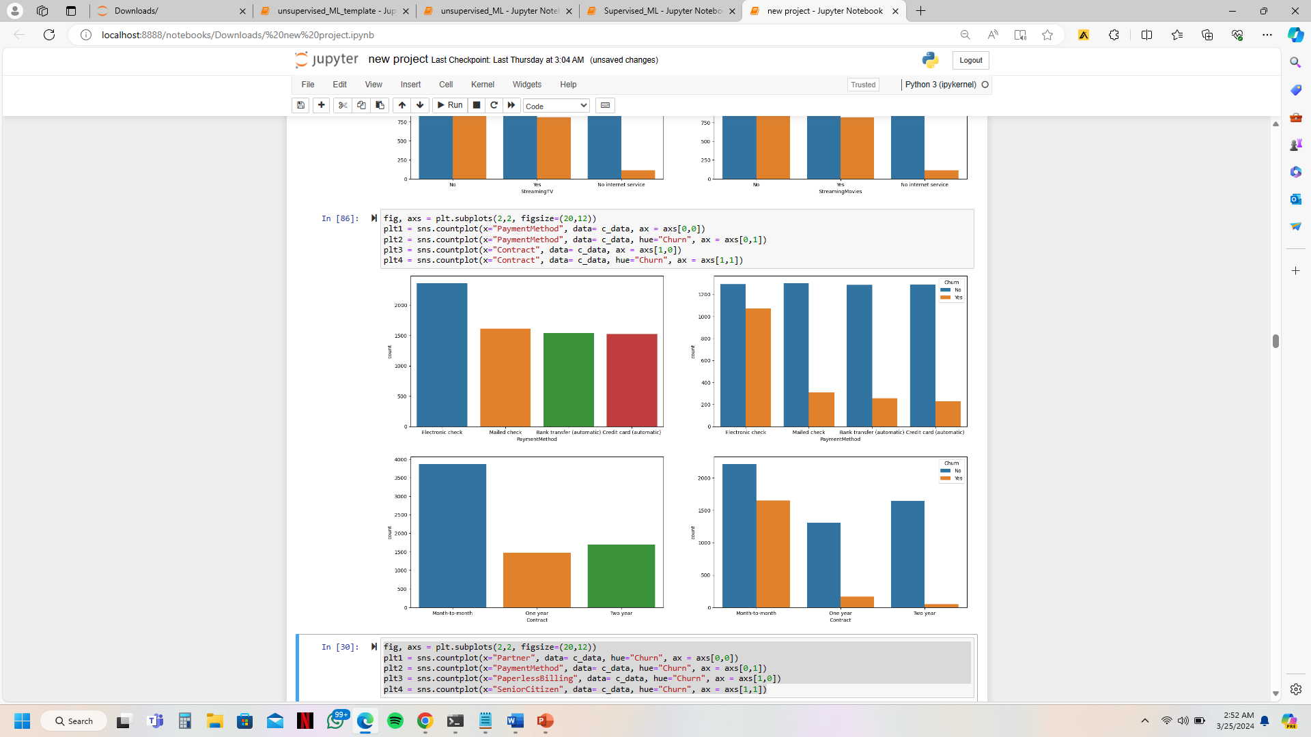
Observations

Slide 11
Logistic regression
Random forest classifier
Stochastic Gradient Descent
Extreme Gradient Boosting
Support Vector Classifier
Gaussian Naïve Bayes
Decision tree classifier
Kneighbors classifier
Models/
Algorithms

Slide 12
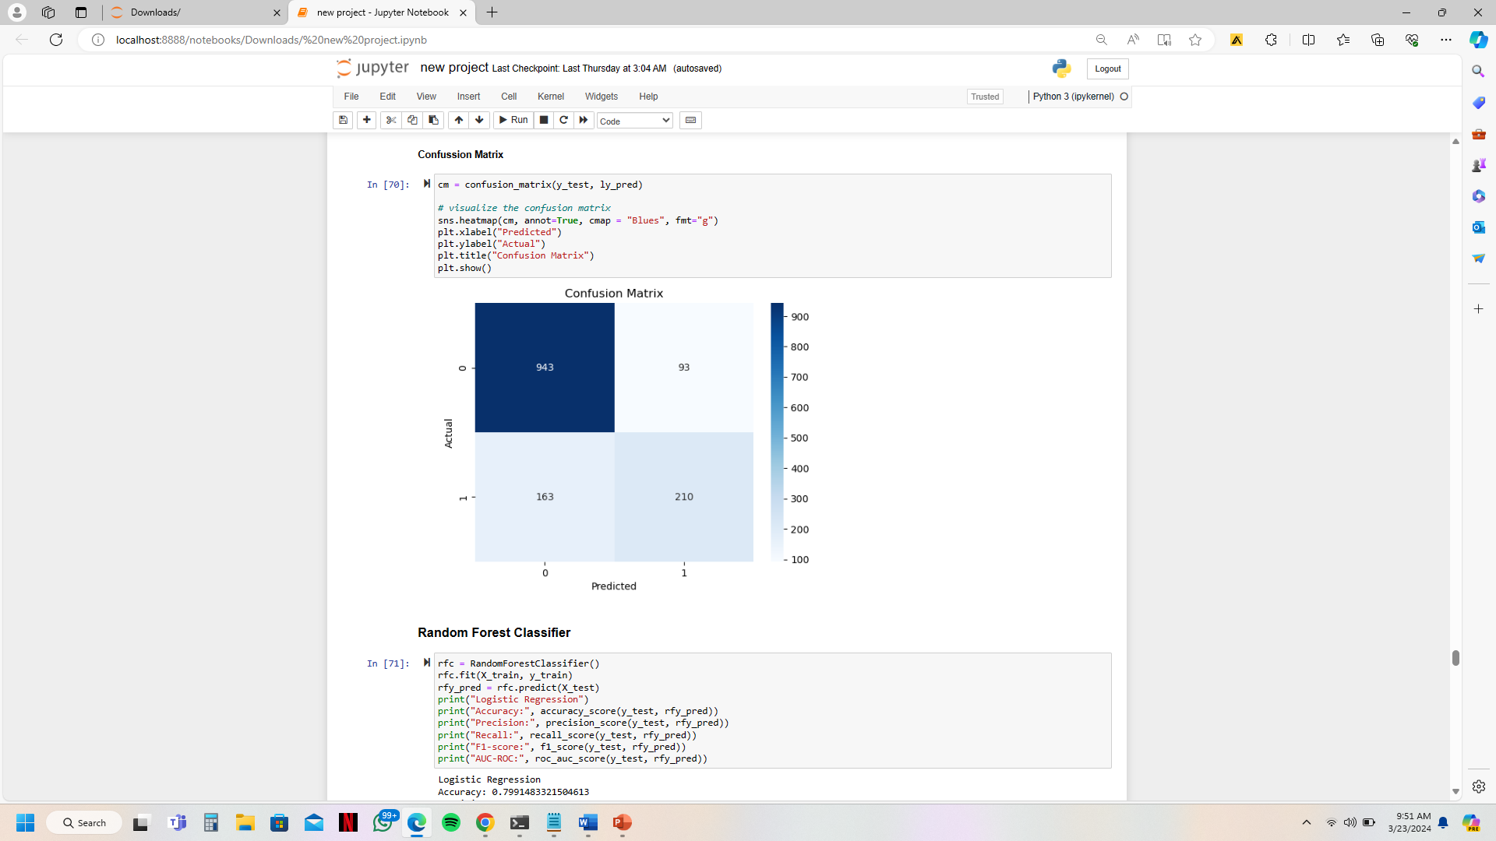
LOGISTIC REGRESSION
Accuracy: 0.8183108587650816
Precision: 0.693069306930693
Recall: 0.5630026809651475
F1-score: 0.621301775147929
AUC-ROC: 0.7366171705984038

Slide 13
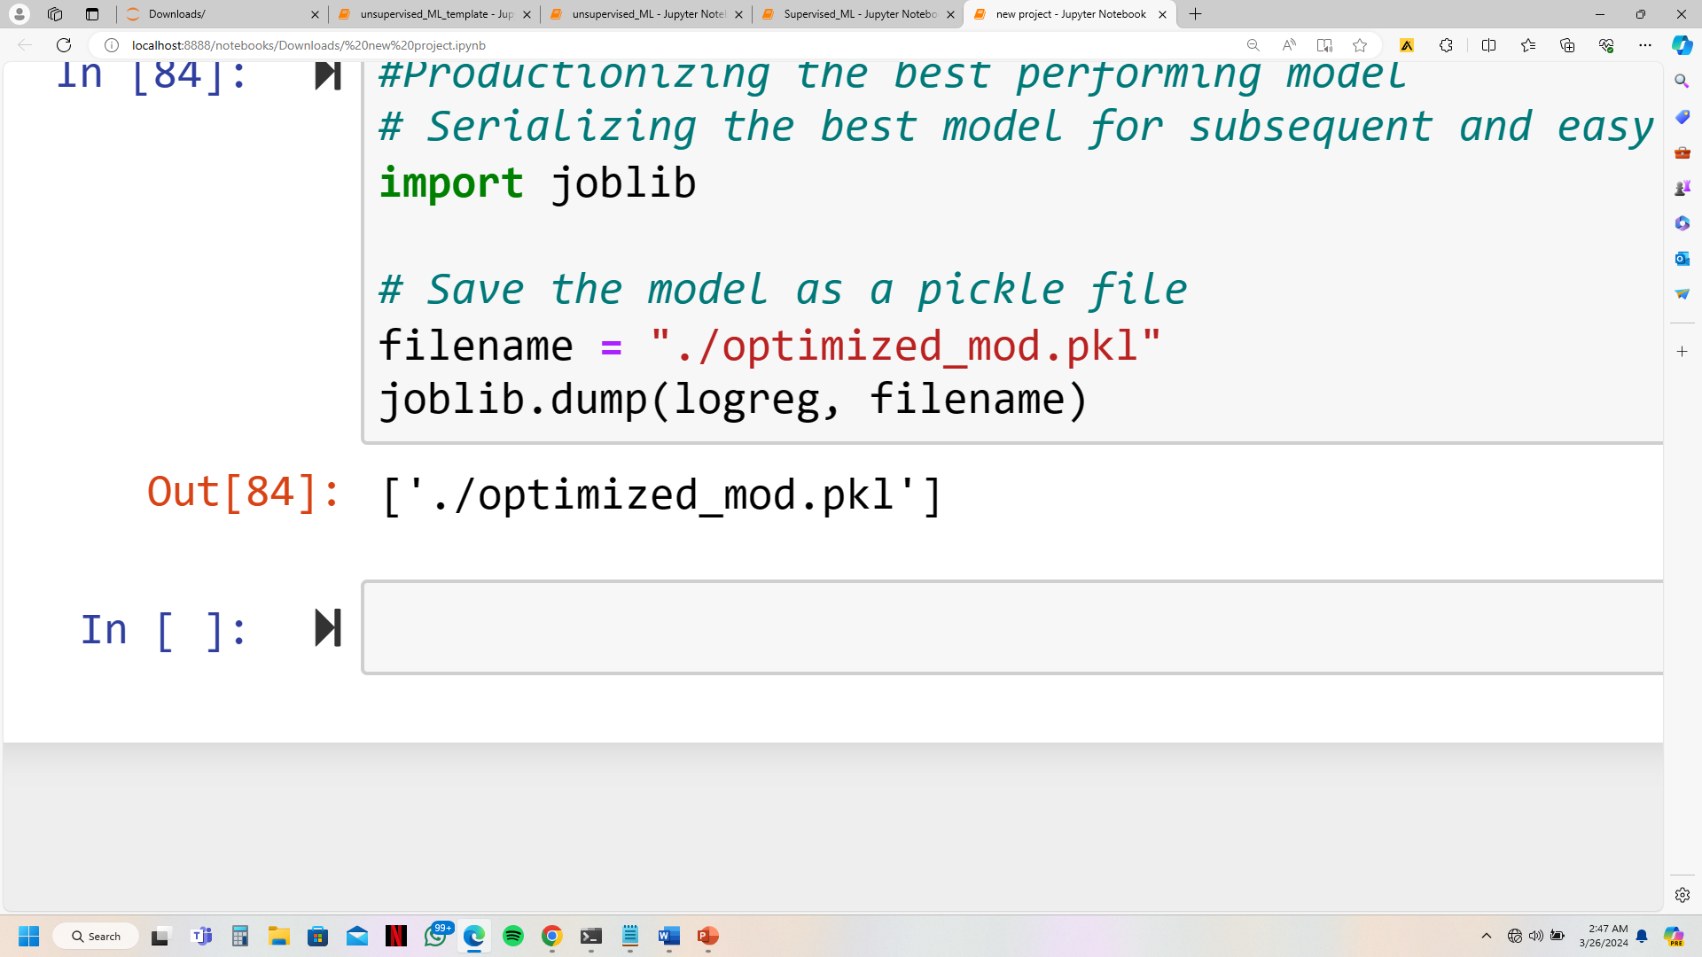

Slide 14
Reduced Customer Attrition
Enhanced Customer Loyalty
Competitive Edge
Cost Efficiency
PROJECT
BENEFITS

Slide 15
Improve Transparency and Communication
Diversify Payment Options
Incentivize Longer-Term Contracts
Focus on Customer Engagement and Satisfaction
Data-Driven Pricing Strategies
Educational Campaigns
Continuous Monitoring and Analysis
Recommendation

Slide 16
Conclusion
Our project aimed to develop a churn prediction system for ConnectTel, revealing insights into customer behavior and churn factors. Variations in monthly charges, tenure, and total charges highlighted the importance of transparency and trust in customer relationships. Electronic check payments and month-to-month contracts were linked to higher churn rates compared to other features, suggesting a need for diversified payment options and incentives for longer-term contracts.
Recommendations focus on mitigating churn risks and enhancing customer loyalty through targeted retention strategies. ConnectTel must prioritize continuous improvement and innovation to adapt to evolving customer needs and market dynamics. Gratitude to everyone for their support, with confidence that our efforts will drive ConnectTel's success.
Thank You !

